Slide 1
HybridNAV: A Hybrid Approach to Zero-Shot Object Detection with Adaptive Exploration for Autonomous Reconnaissance
Hemanth Indurthi · Eric Martinson, PhD | Lawrence Technological University
DISTRIBUTION STATEMENT A.
Approved for public release; distribution is unlimited.
Notes:
Autonomy & Robotics technical session. Twenty-minute slot including a few minutes for questions, so pace for roughly fifteen minutes of content - about seventy seconds per slide.

Slide 2
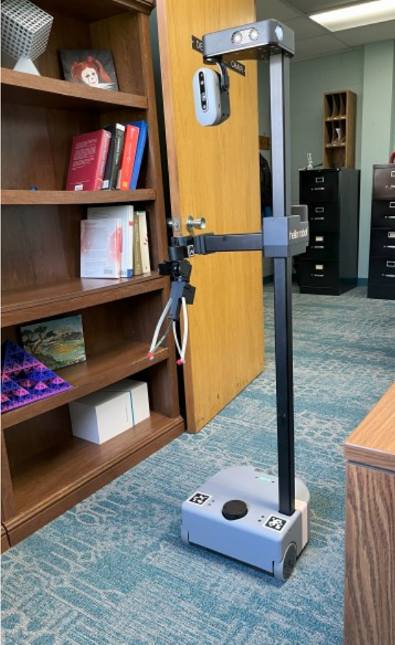
The reconnaissance problem
Autonomous ground systems tasked with reconnaissance must locate objects of interest in environments they have never seen. Three constraints define the problem.
No prior training data. Targets change with every mission and every new piece of intelligence; retraining a detector per objective doesn't scale.
No reach-back. Contested environments mean communication-denied operation, which often rules out cloud processing.
No datacenter onboard. Small unmanned platforms carry laptop-class compute and tight power budgets.
Closed-vocabulary detectors, cloud-dependent models, and monolithic zero-shot systems each break on at least one of these. HybridNAV is built for all three.
The Stretch 2 testbed
Notes:
Frame the problem before the system: unknown spaces, shifting target lists, no network, no large GPU. Each constraint eliminates one family of existing approaches, and that gap motivates the hybrid design.

Slide 3
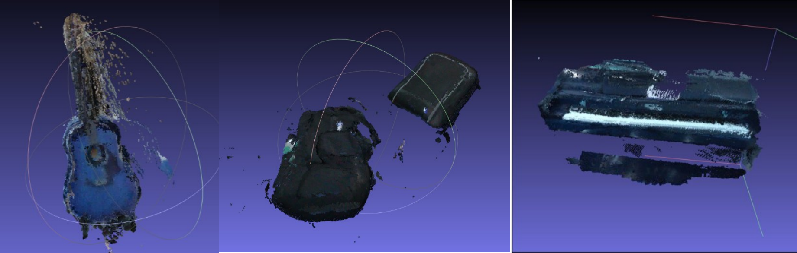
HybridNAV at a glance
Research question - when does a hybrid multi-model pipeline beat a monolithic detector for autonomous reconnaissance?
Hybrid detection pipeline. Grounding DINO, SAM v2, CLIPSeg, and DBSCAN fused for robust zero-shot detection
  +24% macro F-score over single models.
Adaptive navigation. A priority-based FSM balances object-centric investigation with frontier exploration
-25% scan time, -30% path length.
Communication-independent. All processing local on resource-constrained hardware
3.2 Hz, sub-100 ms, nothing leaves the vehicle.
Point-cloud detections from ScanNet scenes: guitar, backpack, upright piano. Per-point color encodes detection confidence.
Notes:
The framing is a research question, not a claim that hybrid always wins - the final slide answers it honestly. The three contributions structure the talk in order. Validation: ten ScanNet scenes offline plus physical trials on the Stretch 2.

Slide 4
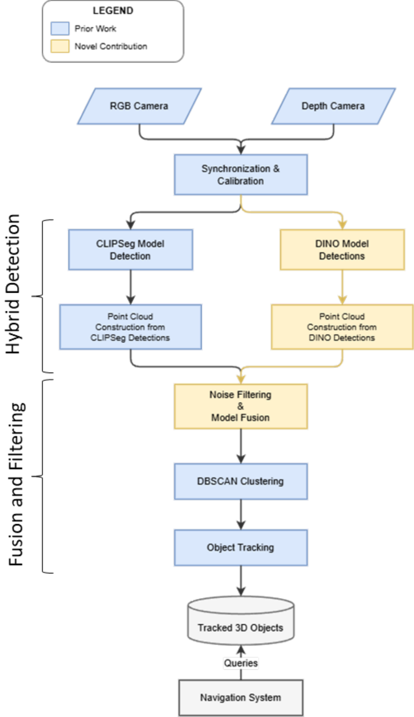
Perception: a division of labor
Precision path. Grounding DINO returns language-grounded boxes from the mission prompt set; each box, enlarged 10%, prompts SAM v2 into pixel-accurate masks.
Recall path. CLIPSeg segments the same frame open-vocabulary, catching what the precision path misses - the unusual and the loosely described.
Three-pass fusion. SAM pixels within 0.20 m of CLIPSeg detections earn a weighted-average confidence boost (×1.1); DBSCAN then clusters the fused 3D points, with density-aware decay penalizing sparse clusters.
Persistent IDs. Stable tracking across frames enables multi-view confirmation that suppresses false positives over time.
Perception pipeline
Notes:
Design principle: each model gets the job it is best at - DINO plus SAM for precision, CLIPSeg for recall, the fusion filter as arbiter. If asked about alternatives: YOLO-World, LISA, and PointCLIPv2 were evaluated during development; none matched the precision-recall complementarity of this pairing.

Slide 5
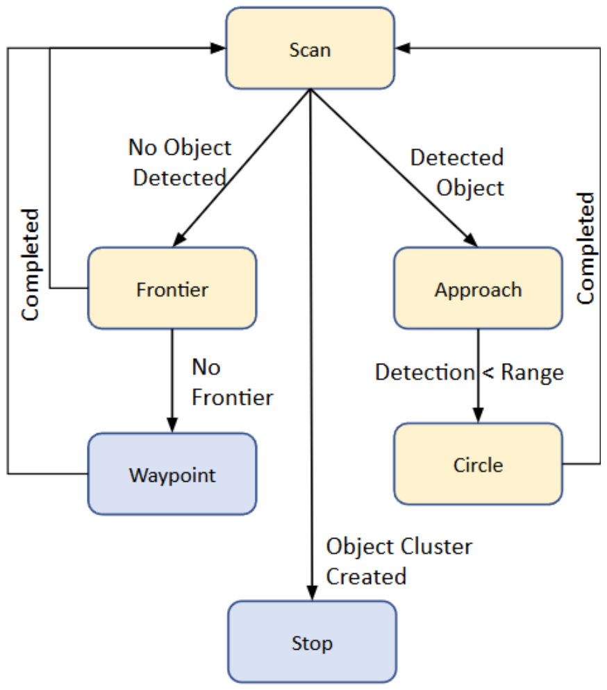
An FSM with priorities
Six states, strict hierarchy. Object-driven investigation outranks frontier exploration, which outranks waypoint coverage - high-value targets first, systematic coverage guaranteed.
Scoring. score = confidencemax / (n + 1), where n is the number of views of the cluster - the most confident, least-observed object wins.
Confirm before moving on. Approach closes range and runs a full 360° pan-tilt scan; below three viewpoints, Circle orbits with efficient tilt-only scans; Stop requires sufficient confidence, point-cloud quality, and viewpoint diversity together.
Re-taskable in the field. Mission target lists are natural-language prompts, updated without retraining as intelligence evolves.
Navigation finite state machine
Notes:
Walk the diagram: Scan detects; Approach closes range and runs the full 360 pan-tilt scan; below three viewpoints, Circle orbits at fixed radius with tilt-only scans, which are cheaper than full sweeps; Stop requires confidence, point-cloud quality, and viewpoint diversity together. Motion between states is a potential-fields controller; a brief random rotation escapes local minima in clutter.

Slide 6
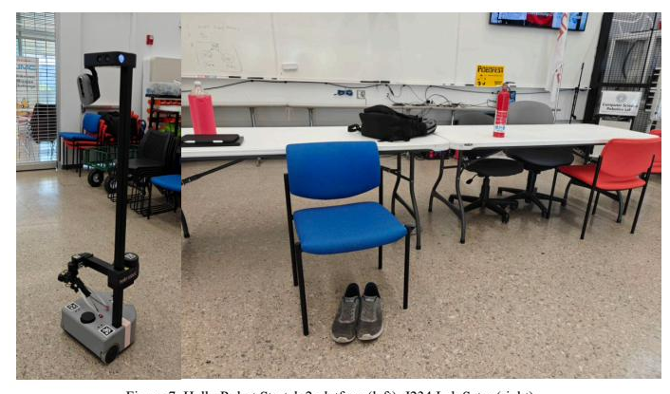
How we tested it
Two Scenarios
Offline benchmark. Ten ScanNet indoor scenes isolating detection quality; IoU ≥ 0.50 greedy matching, macro-averaged per class, frame, and scene.
Live trials. Real-time trials of the full perception-to-navigation loop on the physical platform in a controlled laboratory environment.
Robot - Hello Robot Stretch 2 with RealSense D435i RGB-D, Hokuyo URG-04LX LIDAR, and onboard i7-8650U + NVIDIA MX450 - ROS on Ubuntu, no external compute.
Algorithmic Variations
Detection baselines. CLIPSeg alone · OMDet + SAM v2 · Grounding DINO + SAM v2 (no fusion).
Navigation baseline. Static waypoint tour with no perception feedback, on the same motion controller.
Stretch 2 and the lab trial environment
Notes:
Two regimes on purpose: ScanNet isolates detector quality with ground truth and greedy one-to-one matching at IoU 0.50; the lab trials close the full loop in real time on real hardware. Identical frames, parameters, and motion controller across baselines, so differences are attributable to the approach.

Slide 7
Balance beats specialization
+24%
macro F-score vs. the best single model (0.59 vs. 0.48)
CLIPSet / OMDet / Dino+SAM: very similar F1 scores, often missing several targets
HybridNAV: 0.59 F1 score - finds targets without flooding the operator with false alarms.
Notes:
Table 1 from the ScanNet benchmark. The point is the shape of the bars, not just the height: single models are lopsided - OMDet all precision, CLIPSeg leaning recall - while the fusion is the only balanced pair. Cluster density stays comparable to the best baseline, so the density-aware decay is not discarding evidence.

Slide 8
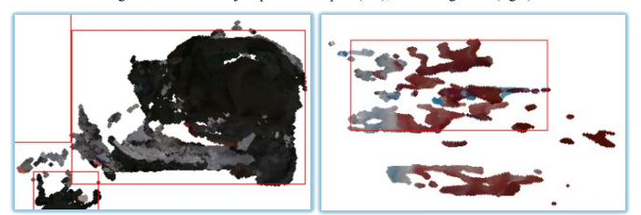
Biggest gains: far and small
+0.09-0.15 F1
on far and small targets - the object classes most sensitive to viewpoint diversity, validating the persistent-ID tracking and scan actions.
Backpack (near) vs. fire extinguisher (far) - on-device detections
Notes:
The paper reports this finding qualitatively - performance particularly excelled on far and small objects; these bar values are the stratified analysis from the thesis behind that sentence. If pressed, cite them as thesis results. Persistent-ID tracking plus the scan actions are what buy the margin on these hard cases.

Slide 9
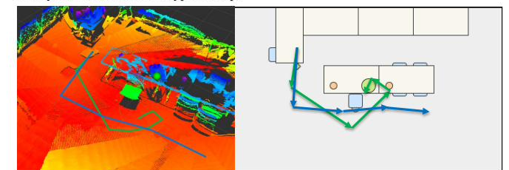
Shorter paths, faster coverage
-30% path length
relative 0.70 vs. 1.00 for the static waypoint tour
-25% scan time
20 s vs. 25 s per scene - while still confirming every target
High-value targets get investigated first; frontier exploration fills coverage gaps. Less motion also means lower cumulative motor usage - longer effective missions on battery.
Green: HybridNAV's object-aware trajectory · Blue: the conventional waypoint loop
Notes:
Table 2, real-robot trials. The efficiency is a by-product of coupling: perception tells navigation what deserves attention, so the robot stops sweeping blindly. Additional thesis-only numbers if asked: navigation time fourteen versus twenty minutes, battery remaining seventy versus fifty percent, and a random-frontier baseline that was worse on every metric.

Slide 10
Real time, on the vehicle
3.2 Hz
sustained end-to-end perception → decision throughput
<100 ms
end-to-end latency, sensor frame to navigation decision
0
external dependencies - no cloud, no reach-back, nothing transmitted
The full multi-model pipeline runs on COTS hardware (i7-8650U + MX450) with utilization within bounds for extended missions - feasible for integration with existing military robotic platforms.
Notes:
System performance section. Detail if asked: mean utilization 57 percent CPU and 68 percent GPU in the thesis measurements; frame rate within about six percent of a single-model baseline despite running two extra models; the one recorded 110 ms spike coincided with a SLAM keyframe insertion during a 360 scan.

Slide 11
What this buys the warfighter
Re-tasking without retraining. Mission planners update the target list between deployments - “backpack,” “wire bundle,” “electronics on floor” - with no ML expertise and no retraining infrastructure.
Communication-independent. Full operation in GPS-denied, comm-contested environments - and none of the latency or vulnerability of shipping sensor data to remote servers.
Aligned with reconnaissance practice. Priority-based navigation investigates high-priority targets first, then systematically clears remaining areas.
Modular by design. Components upgrade independently as better models arrive; tuning is per-mission - favor recall in high-stakes scenarios, or swap in a domain-fine-tuned model.
Notes:
Every line here traces to the implications section of the paper - nothing speculative, and the example prompts are the paper's own. Modularity also answers the question of what happens when a better model ships: swap it in.

Slide 12
When does hybrid win?
The hybrid advantage is largest for:
1 · Esoteric or domain-specific objects outside the training distribution of large monolithic models.
2 · Spatial relationship reasoning - “the object near the doorway,” “unusual items on the floor.”
3 · Missions where multi-view confirmation is essential to suppress false positives.
Where monolithic wins
For common, well-represented categories in controlled settings, monolithic models such as SAM v3 may offer comparable or superior performance with lower architectural complexity.
HybridNAV's value is strongest in the open-ended, unpredictable conditions that define reconnaissance.
Notes:
This is the conclusion's answer to the research question from the overview slide, and it preempts the SAM v3 question from the audience. Conceding the controlled-setting case strengthens the reconnaissance claim, which is the one this audience cares about.

Slide 13
Takeaways
1 Fusion beats monoliths for open-vocabulary reconnaissance: +24% F-score with balanced precision and recall.
2 Perception-aware navigation is free efficiency: -30% path length, -25% scan time on the same motion controller.
3 It all fits on the vehicle: 3.2 Hz, sub-100 ms, zero reach-back - deployable where the network isn't.
Next: field trials in operationally relevant settings - outdoor terrain, multi-floor structures, degraded visibility.
Hemanth Venkata Indurthi - hindurthi@ltu.edu · Eric Martinson, PhD - emartinson@ltu.edu | Lawrence Technological University | GVSETS 2026, Novi, MI
Notes:
Close on three numbers: twenty-four percent, thirty and twenty-five percent, and 3.2 hertz with zero reach-back. Field trials are the stated next step: outdoor terrain, multi-floor structures, degraded visibility. Then open for questions.

